Slide 1

The researchers’ voice on the EHDS
Giulia Ghilardi

Slide 2
The European Health Data Space (EHDS)
A European framework designed to improve access to and exchange of health data
Primary use
Health data used for healthcare and treatment
Secondary use
Health data reused for research, innovation, public health and other purposes

Slide 3

The EHDS & research
Health data are generated across many different sources:
  Electronic Health Records
  Patient registries
  Research infrastructures
  Disease registries
  Other health-related datasets
The challenge: How can we make these data accessible, interoperable and trustworthy for research while respecting legal and ethical requirements?

Slide 4
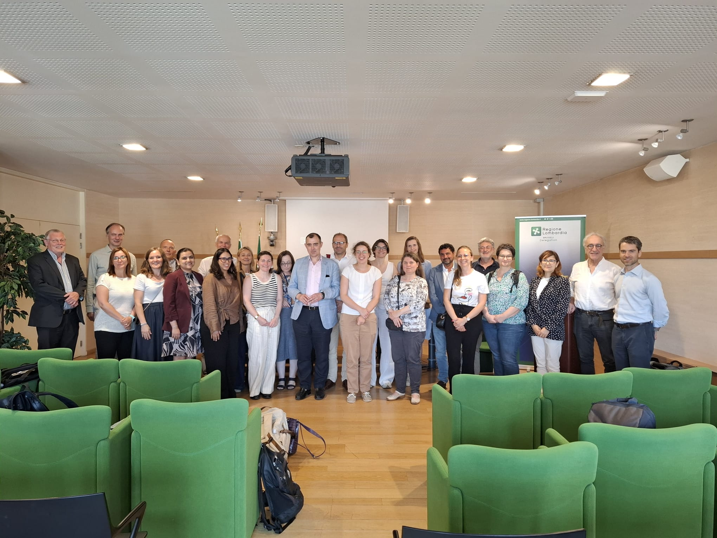
The EHDS & the researchers: our workshop
Learning from Practice: Research perspectives on the secondary use of health data & the EHDS Implementation (Brussels, 29 June 2026)

Slide 5
Objectives
Bringing the perspective of the research community into the EHDS implementation process, particularly:
Share practical experiences on the secondary use of health data
Discuss the use of electronic health records and patient registries
Identify implementation challenges
Develop recommendations for EHDS implementation and research policy
Strengthen dialogue between researchers and policymakers

Slide 6
Areas of Discussion
Data Quality
How can we make health data reliable and useful for research?
Data Governance
How should data infrastructures, access bodies and data holders work together?
Ethical, Legal and Societal Issues
How can research respect legal requirements, ethical principles and public expectations?

Slide 7
Data quality
Two dimensions
  Intrinsic quality of the dataset
  Fitness for a specific research purpose
Importance of
  High-quality metadata
  Common semantic models
  Clinician engagement
Continuous feedback can improve data quality at the point of data generation
AI and synthetic data require
  Transparent validation
  Benchmarking
  Trustworthy and reproducible methodologies

Slide 8
Data Governance
Build on existing research infrastructures
Integrate:
  Federated networks
  Disease registries
  Existing data-sharing mechanisms
Key challenges:
  Long-term sustainability
  Role of Health Data Access Bodies (HDABs)
  National technical and financial capacity
  Fee systems
Need for incentives for data holders

Slide 9
Ethical, Legal and Societal Issues
Interaction between EHDS, GDPR and national frameworks
Treatment of legacy datasets
Broad consent and opt-out mechanisms
Anonymised, pseudonymised and synthetic data
Practical application of data subject rights
Public trust, transparency and engagement

Slide 10
Recommendations for Future Implementation
Practical guidance is needed on:
  Data mapping and annotation
  A common semantic model
  Anonymisation and pseudonymisation
  AI and synthetic data validation
  Computational resources and data access
  Interoperability across European data spaces
Pilot use cases should be developed across different research domains

Slide 11

Now?
Working on a position paper: “The long march through the EHDS: hurdles and opportunities along the research journey”
Structured as a journey:
Giulia, a cancer researcher based in Italy, needs health data from several EU Member States. Today she faces fragmented rules and infrastructures, what within the EHDS?

Slide 12





The journey
Finding datasets
Obtaining access
Using the data
HDAB
SPE
Notes:
1- Identifying the datasets available across Europe.
2-Permits from national Health Data Access Bodies (HDABs) and analysis in secure environments.
3-Producing scientifically valid and societally valuable research.

Slide 13
The journey
Finding datasets
Obtaining access
Using the data
EASY…!
HDAB
SPE
Notes:
1- Identifying the datasets available across Europe.
2-Permits from national Health Data Access Bodies (HDABs) and analysis in secure environments.
3-Producing scientifically valid and societally valuable research.

Slide 14
The journey
HDAB
SPE
Notes:
1- Identifying the datasets available across Europe.
2-Permits from national Health Data Access Bodies (HDABs) and analysis in secure environments.
3-Producing scientifically valid and societally valuable research.

Slide 15
Step 0
Structural and systemic issues affecting the EHDS implementation
Limited awareness of the EHDS
  It can hinder participation by health Data Holders
  No political priority
Inadequate funding
  Questions of healthcare priority-setting

Slide 16
Step 1
Issues related to data finding activities
Quality of data catalogues
  Incentives for data holders:
  Economic (fee system)
  Scientific
Quality of data
  Incentives:
  Feedback to healthcare professionals
  Quality at the source (EHR)
  Feedback from data users
  Professional recognition to data stewards
Support from intermediation entities
  → To reduce the administrative burden on health data holders

Slide 17
Step 2
Issues affecting data access
Challenges for HDABs
  Overlapping responsibilities among HDABs, data-protection authorities, ethics committees → duplicated scrutinies and delays
  HDAB requires legal, ethical, scientific and technical expertise
Existing data infrastructures
  May need to be adapted or connected to the new architecture
National fee systems
Duplicate data downloads
  Need for a system to track and identify overlaps

Slide 18
Step 3
Issues related to secondary use
Access to high-quality datasets
  General datasets quality
  Study specific quality (Fitness for use)
Access to high-quality AI models
  No specific governance framework
  No obligation to return models or parameters
Research-related and broader ethical and societal implications
  Under-represented populations
  Interaction between research consent and the opt-out framework
  The effective excercise of opt-out right
  Public trust
  Legal and institutional fragmentation

Slide 19
The future
WINNER! (?)
Notes:
1- Identifying the datasets available across Europe.
2-Permits from national Health Data Access Bodies (HDABs) and analysis in secure environments.
3-Producing scientifically valid and societally valuable research.

Slide 20



THANK YOU
FOR YOUR
ATTENTION
ecream@marionegri.it

Slide 21


